Slide 1
Cloud Continuous Delivery/Deployment
Fabian Fichter
https://github.com/fafi2/CloudScripts-Showcase

Slide 2
It‘s a customer story…
This approach is part of the cloud strategy of a customer project
It’s used productively
Proved to scale from a technical as well from a team/development perspective

Slide 3
What’s Cloud?
The part I’d like to highlight:
Cloud is a layer of abstraction which lets you focus on
your business case
configuration
behavior
orchestration
…

Slide 4
Project context
Analytics services used to provide insight into build pipeline
About 4000 builds per day data produce data for further analysis:
Quality: custom maturity model
~930000 component results per day
Various views show the quality of a project/build/component in detail or over time
Build duration: ~10h
Build configuration: builds are very configurable which makes analysis a challenge
Machine monitoring: ~400 nodes build software 24/7
Logs: ~100.000.000 log lines are analyzed per day

Slide 5
Project context
2 big parts
Build pipeline
REST services
Analytics, Importing data, monitoring
Focus of this approach is part 2: REST services

Slide 6
Task regarding cloud and CD in this project
An approach is needed to apply a continuous delivery workflow
Shall be consistent over all deployments
Shall enable continuous deployment
For onprem there is an existing heavily used docker based framework: Dockerscripts
Models continuous delivery workflow
Constraints
First usable solution urgently needed because onprem resources running out
The learning curve for understanding and defining deployments shall be steep.
Kubernetes is initial target

Slide 7
Quick intro Kubernetes
Open source container orchestration
Live-Demo

Slide 8
Strategy cloud deployments
Let’s take the good ideas from Dockerscripts and apply fresh new stuff where needed
Good: All deployments follow the same conventions regarding the workflow and release lifecycle and it’s easy to create new deployments, very small core, run-repositories
Bad: no tests, no cluster management, difficult to request resources
Idea of CloudScripts was born
models deployment workflow
Core paradigms:
Ability to change
Use the right tool for the job

Slide 9
Goals
enable continuous delivery/deployment in the cloud (starting with Kubernetes)
increase deployment/release rate
enable an easy and smooth movement to cloud
boost collaboration regarding cloud know-how
support learning cloud features
steep learning curve
benefit from existing knowledge within the team

Slide 10
Solution Idea
deployments are pure code
deployments are executed as tests
framework provides base functionality for deployment definitions
actual deployments can be done using template patterns

Slide 11
Advantages using real code
we can use the same tools/frameworks we also use for other programming tasks
direct support of syntax highlighting, refactorings via an IDE
dependency management out of the box via e.g. gradle
well known build tools can be used for deployment flow definition
automated testing of CloudScripts itself and the actual deployments easily possible
we can easily combine external inputs
we can apply the same patterns/considerations/best practices we normally do when coding:
avoid repetition
use well known design patterns
ability to introduce abstractions

Slide 12
Abstractions provided by CloudScripts
CloudScripts provides various layers of abstraction to let the user focus on a certain task or idea hiding other stuff for a moment.
The patterns Single Layer of Abstraction and Separation of Concerns are used throughout the whole framework to reach that.
Core Abstractions
Spec
Microservice
Unit
Config
K8s

Slide 13
Architectural decisions
Artifactory as basis for release management
Gradle as basis for build, dependency and execution management
Jenkins usage: thin wrapper to use Jenkins as execution container
GitHub as basis for change management
Groovy as basis for deployment definition

Slide 14
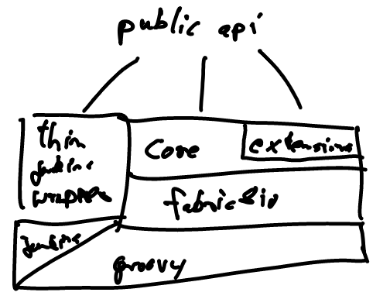
CloudScripts Architecture

Slide 15
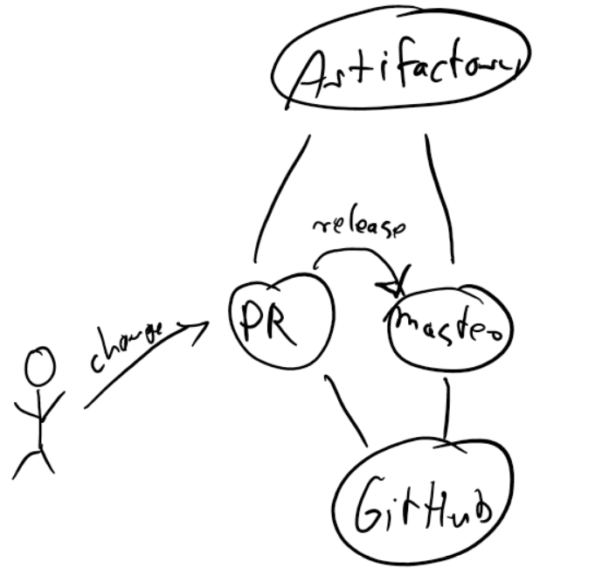
Development process CloudScripts
CloudScripts uses continuous deployment as basis for development

Slide 16
Risks
CloudScripts is not ready early enough
because our on-prem resources are running out
CloudScripts hides Kubernetes too much
CloudScripts adds unnecessary complexity to deployments
CloudScripts is not extensible enough

Slide 17
Benefits CloudScripts
Unified approach in the overall project
Makes use of common technologies used in the team
Enables unit tests
Enables individual tests within deployments
Enables advanced infrastructure tests inside pull requests
No technology break: team members can code in groovy which is well known in the team
We can introduce and share abstraction, e.g. consul service discovery, analysis stacks, …

Slide 18
CloudScripts live coding
The acme corp has following request:
A new functionality was implemented but it seems not working all the time. This is only the first part of a group of features which shall be debugable/analyzable
Task: a generic solution for analyzing logs shall be implemented
We will do that together in a live coding session

Slide 19
Next
Currently CloudScripts is closed source developed using a private GitHub repo
There are efforts to make it open source

Slide 20
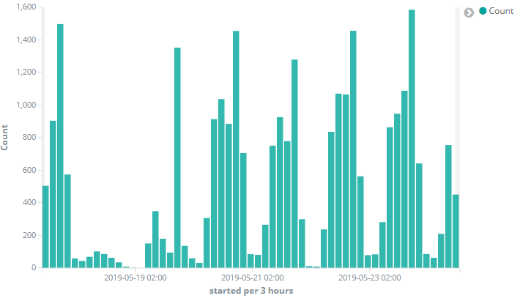
Project context stats: builds

Slide 21
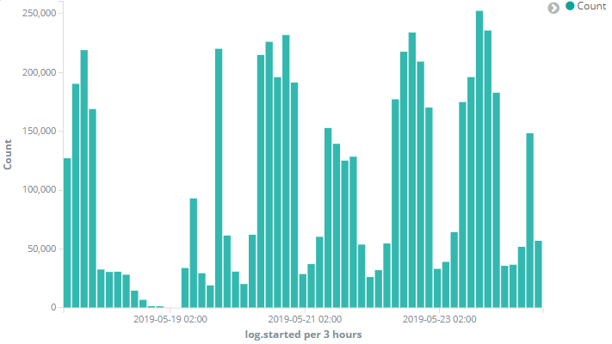
Project context stats: results

Slide 22
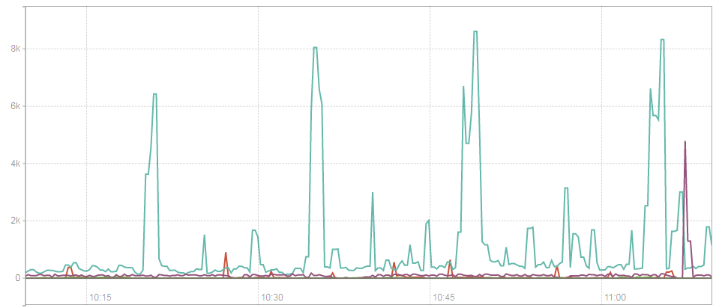
Project context stats: Log lines per group

Slide 23
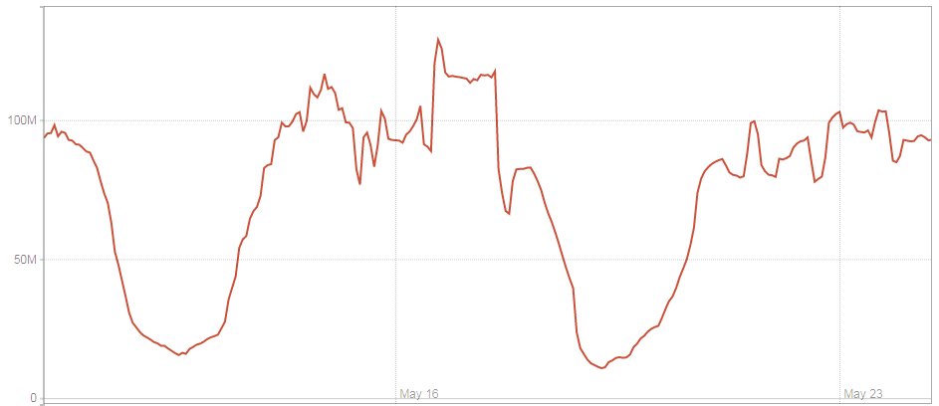
Project context stats: logs in the last 24h per timestamp

